Slide 2
This course has encouraged me to transform from an Intensive Autonomous Leader into a Servant Leader.

Slide 3
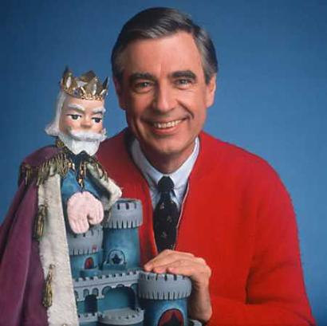
Huh? And, what? Put differently, adjust from a lone wolf leadership style to a Mr. Rogers leadership style.

Slide 4
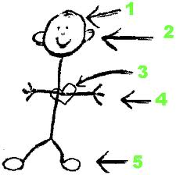
Mr. Rogers equals a Servant Leader because he was notable for accepting others.

Slide 5
Servant Leaders: 1. Honest 2. Listeners 3. Appreciative of others 4. Competent 5. Encouragers

Slide 6
So, why would an autonomous leader want to transform into a Servant Leader?

Slide 7
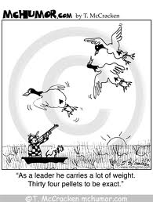

Slide 8
Servant Leadership is one of many paths that lead to high performance and success for any company.

Slide 9
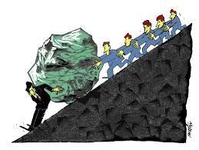

Slide 10
“Servant Leaders are driven by the beliefs that they are in their roles for the benefit and support of those people that they are charged to lead while the idea of servant leadership initially evolved from calls for leaders to behave in a more Christ-like manner; they do not necessarily have to approach their roles from a particularly Christian, or even a religious, perspective.”

Slide 11
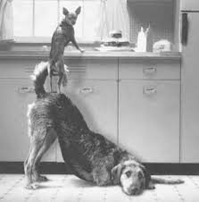

Slide 12
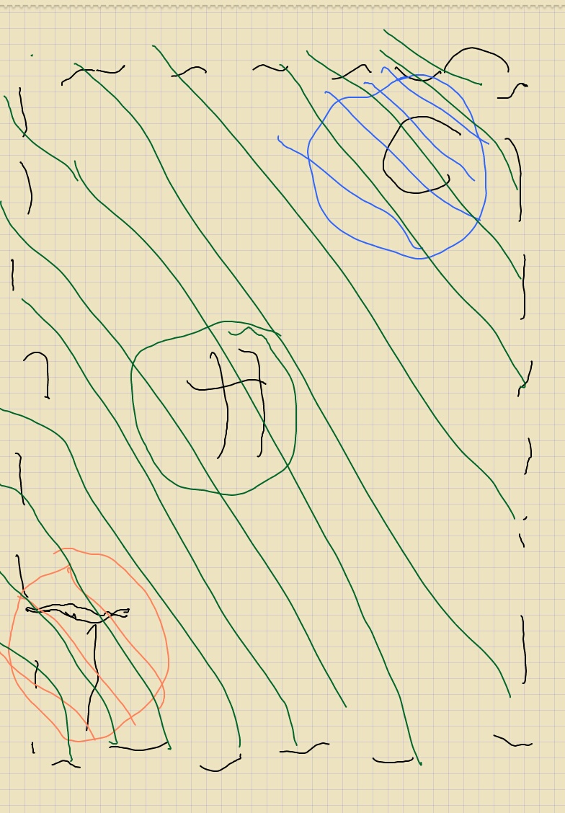
A crude depiction of a Katz Model for a Servant Leader. Notice the green lines flowing throughout this Model. The green lines represent “Human Skills” which are vital skills for achieving and maintaining success.

Slide 13
Servant Leaders value people so they are successful at leading people to work since “work is a social process…done by the people, through the people for the people.” Servant Leaders fosters an atmosphere of teamwork, as well as, supports adding value to the members of a team.

Slide 15
Why, then, is everyone not on the path of the Servant Leader?
“Servant leadership is only one approach to leading, and it isn’t for everyone”.

Slide 16
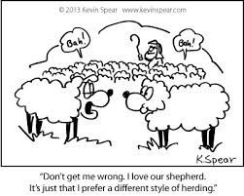

Slide 17
Why, then, do I qualified to be on the path of the Servant Leader? I posses a proclivity toward prescriptive behavior within leadership roles, “assuming workers like work, are creative and that they seek independence.”

Slide 18
Lastly, critics claim Servant Leaders are “tomato cans” -- soft, pushovers.
The positive approach to discipline is not “an alternative way” to all leaders/managers, in fact, the positive approach is the usually way of discipline for servant leaders/managers. Servant leaders are individuals intrinsically motivated to assist “employees take personal responsibility for their [conduct] misconduct”.

Slide 19
Thank You, for listening to how I connected with course material. Enjoy Life! AM.

Slide 20
WORK CITED:
PRT FALL 3207 Lecture Notes/Slides
http://online.ben.edu/blog/leadership/who-are-these-servant-leaders#sthash.pOztyqok.dpuf
Sendjaya & Sarros, 2002
Walker, 2003
http://www.slideshare.net/narayanmurthyp/management-concept-theories
https://greenleaf.org/what-is-servant-leadership/
http://www.butler.edu/volunteer/resources/principles-of-servant-leadership/
http://www.forbes.com/sites/hbsworkingknowledge/2013/05/01/why-isnt-servant-leadership-more-prevalent/
http://technorati.com/business/gurus/article/5-reasons-why-servant-leadership-works/
http://www.regent.edu/acad/global/publications/jvl/vol1_iss1/Spears_Final.pdf
Song by: Nicole Renuard, Le gris(grey)

